Slide 1
Standard User – Collaboration:
View and Compare Contract Revisions
February, 2013

Slide 2

Learning Objectives
Upon completion of this course you will be able to:
Review Contract Revisions
Compare Contract Revisions
View Redline Revisions
View Side by Side Revisions

Slide 3

Contract Revisions
As contracts are reviewed and exchanged among internal parties, they are tracked using “revision numbers”.
  It is sometimes helpful to view the revision history and monitor the review and editing process.
Open a contract from either My Contracts or from a Search.
  The contract is displayed with the Contract Editor opened.
From any tab, click the Contract Revisions icon on the main, blue toolbar.
  The contract Revision History dialog box is displayed.

Slide 4
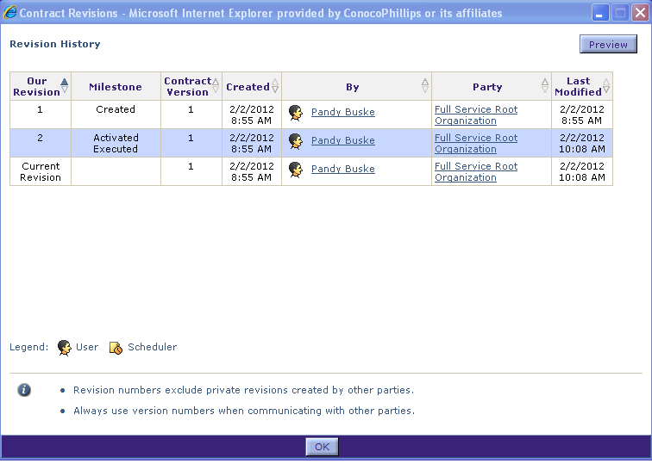
Contract Revisions Preview Option
The Revision History details when a revision was made and by whom.
  All revisions to the contract are listed in order starting the ‘oldest’ revision down to the most recent.
  The “By column indicates who made the change or revision to the contract.
  To preview a revision, highlight the row for a revision number, and click the Preview button.
Review the history of the changes and click OK when done.

Slide 5

Compare Contract Revisions
It is sometimes helpful to compare revisions to evaluate the changes and review the editing process.
From the Language or Header tabs, click the Open icon on the main, blue toolbar.
  The contract is opened in editing mode in MS Word, with the Emptoris toolbar (ribbon) available.

Slide 6
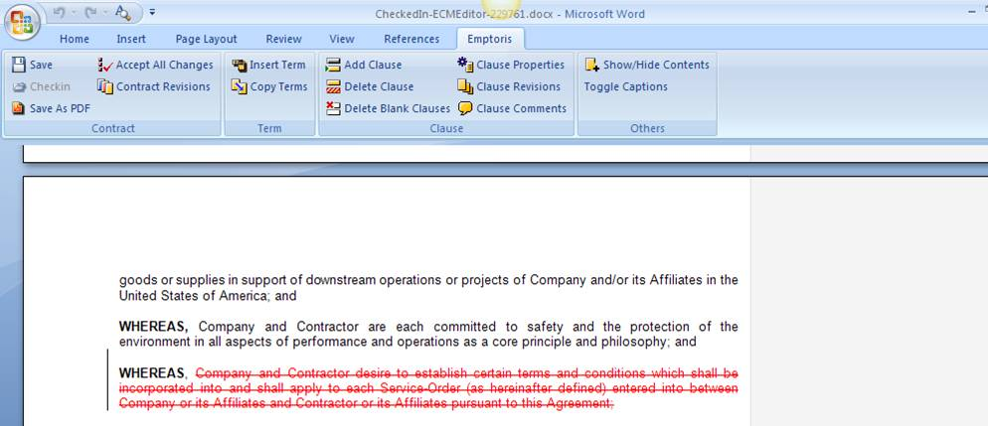
Compare Contract Revisions, cont.
Click the Contract Revisions icon on the Emptoris toolbar of the Language editor.
  The Contract Revisions dialog box is displayed.

Slide 7
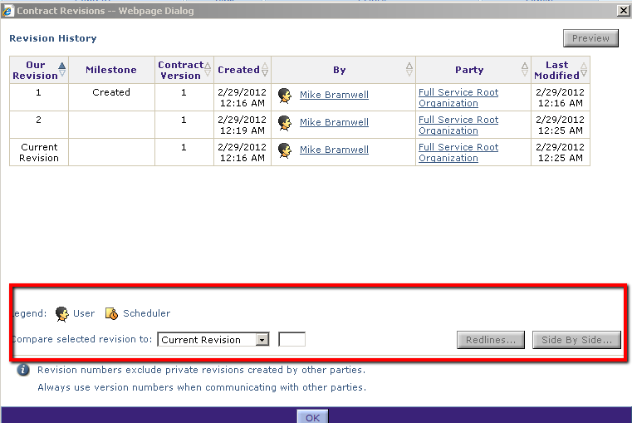
Contract Revisions Dialog box
You can compare the two revisions as either:
  Redlines: displays a single document with the changes “redlined” between the two different revisions, or
  Side By Side: two documents are displayed in adjacent windows.

Slide 8
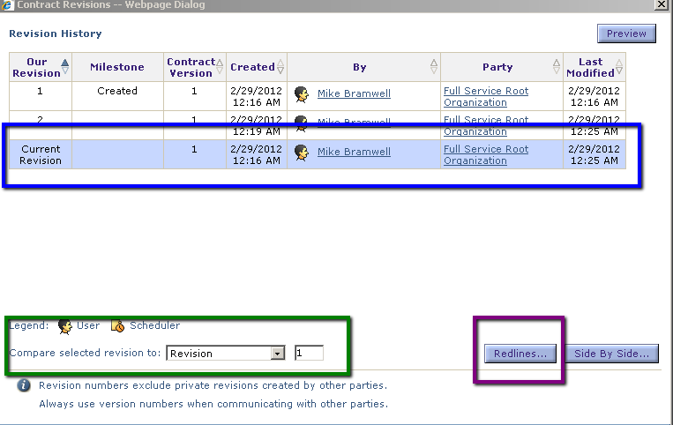
Types of Comparisons
Select the row of the revision to be compared. (blue box)
Select the revision option from the drop down list and enter the revision number (from the Our Revision column) to be compared. (green box)
Select Redlines (purple box)

Slide 9
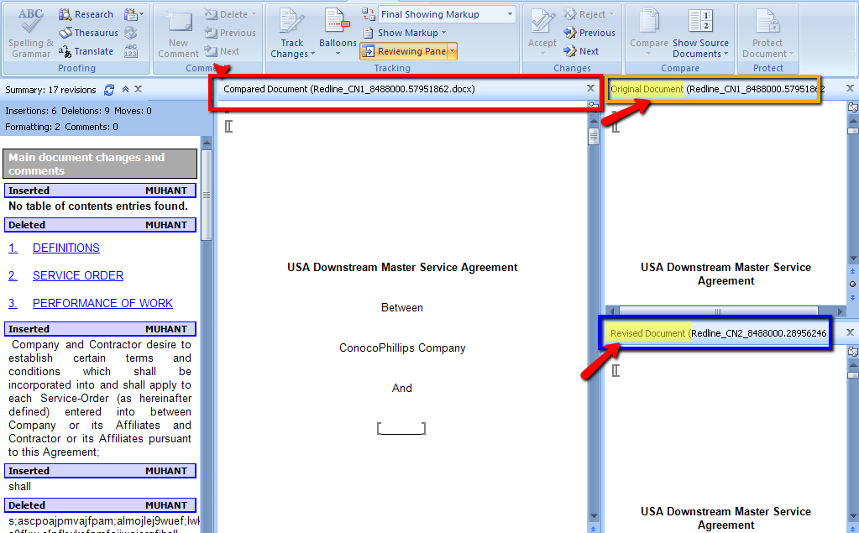
Redlines Option
You can see the Original, Revised, and Compared documents all in one screen.
You can also use the Word tools to manage or edit the document.

Slide 10
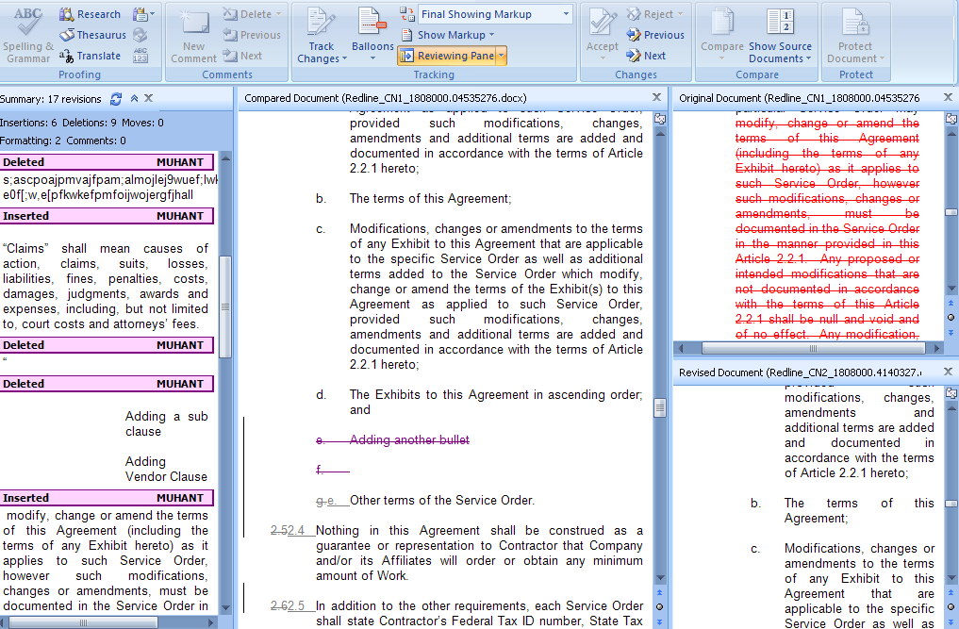
Redlined Revisions Example

Slide 11
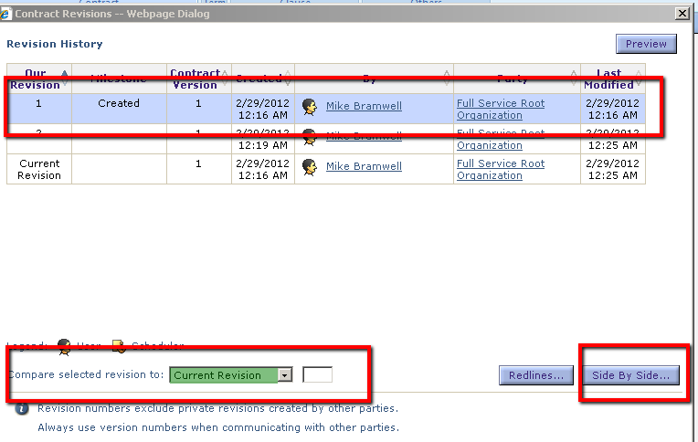
Side By Side Comparisons
To compare documents side by side:
  Highlight the row of the revision to be compared.
  In the Compare selected revisions box (highlighted green), select whether this is the current revision (default) or use the drop down box to select the relevant revision number.
  Select Side by Side

Slide 12
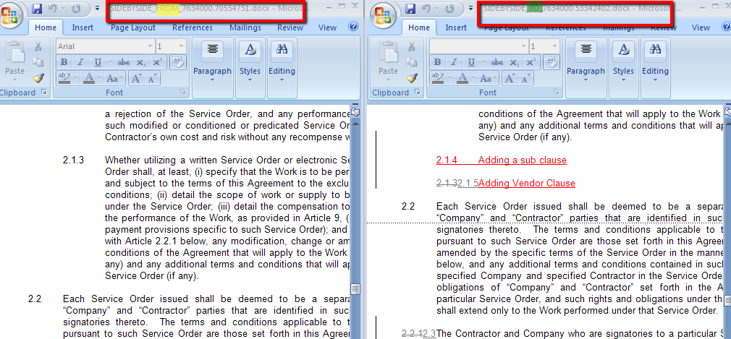
Side By Side Comparisons, cont.
On the address bar at the top of the screen, you will see “From” (highlighted in yellow) and “To” (highlighted in green).
  From is the row highlighted from the Revision History and appears on the left side.
  To is the option selected when prompted to ‘Compare selected revision to’ and appears on the right side.

Slide 13
Side By Side Comparisons, cont.
NOTE: It is a MS Word limitation to only compare two documents at a time in the Side by Side option.
  Revisions build up and accumulate the changes as the document is submitted in the system.
  For example, a contract that has 11 revisions in the system will have all the changes made from Revision 1 through to Revision 11.
  You can also see changes from any point (for example from revision 5 to revision 11).
To close each of the documents, use the Office button > Close option from Word.

Slide 14

Questions?

